Slide 1
A
CREW
grow together.
a DeFi saving plan: intentional, social-driven, and high-yielding.

Slide 2

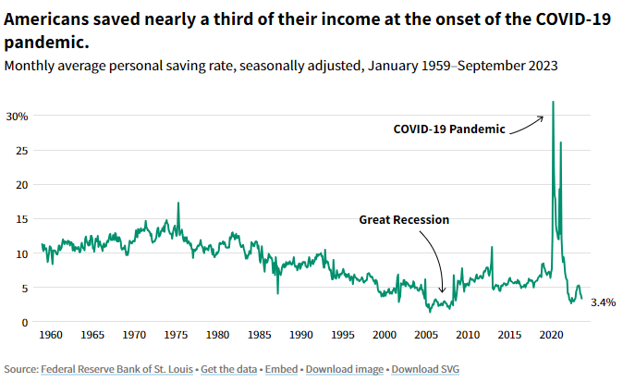
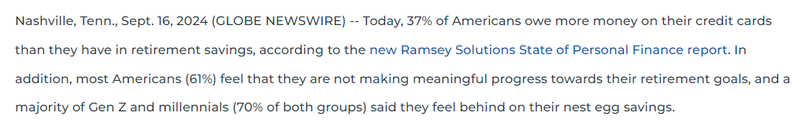
People crave financial security.
But it is difficult to save.
A
CREW

Slide 3

ACREW is a group-accountability savings plan to help you grow financially with your friends & strangers.
By offering concrete, directive plans that encourage completion, we aim to help both banked and unbanked individuals grow in their savings and confidence.
A
CREW

Slide 4
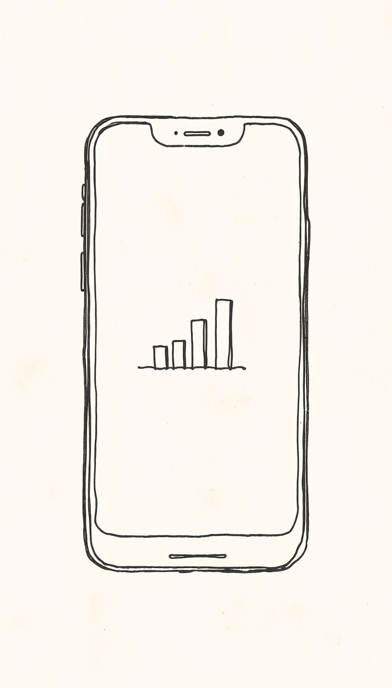
Self-custodial
Capital protected
Social accountability & rewards
A
CREW

Slide 5



A
CREW
Self-custodial Account
Self-custodial Account
Self-custodial Account
Shared Savings Plan

Slide 6



A
CREW
Early Withdraw,
Capital Returned
Bonus Yield
Bonus Yield
Shared Savings Plan

Slide 7
Road Map
Wen? Soon.™️
A
CREW

Slide 8
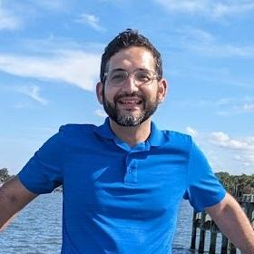
Why me?
Graduated 175k in debt, paid off in 5 years
Taught workshops on financial education, security and growth
Former CFO of non-profit
A
CREW

Slide 9
Market Opportunity
As of 2024, the global decentralized finance DeFi market is projected to reach $30.17 billion, with expectations to grow rapidly at a compound annual growth rate CAGR of over 42% in the next several years. By 2030, the DeFi market is anticipated to surpass $231 billion due to its innovative financial services, such as staking, yield farming, and decentralized exchanges, which attract a growing number of investors and users seeking alternatives to traditional finance (Grand View Research)​
In contrast, the total global size of savings plans, including pension funds, insurance savings, and other formal savings vehicles, represents a much larger sector. For example, estimates indicate that global retirement assets alone are well above $60 trillion, encompassing pensions and individual savings plans​ (Mordor Intelligence)
A
CREW

Slide 10
Fees through partnerships with existing defi protocols to route usage to their staking solutions and platforms.
Potentially fees from broken savings plans, while still protecting initial capital.
A
CREW

Slide 11
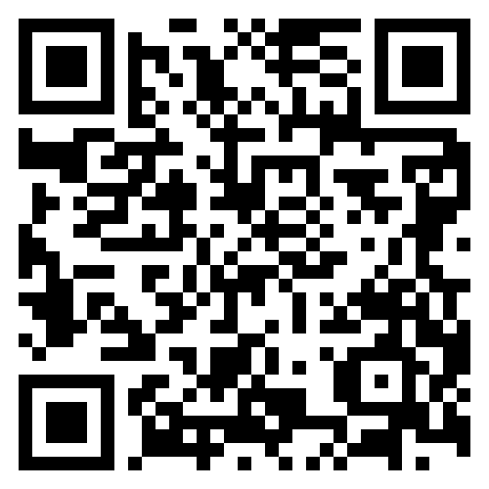

Register today
A
CREW

Slide 12
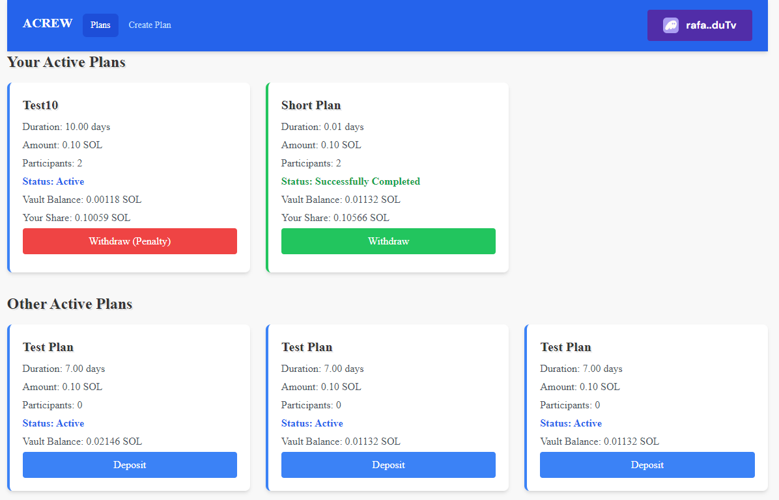
A
CREW

